Slide 1
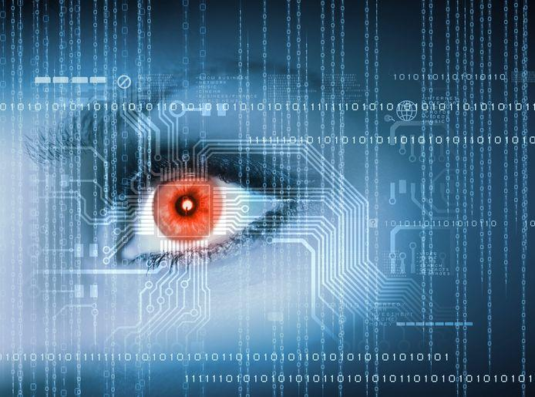
PowerAI Vision Understanding the Details —
Chris Eaton (ceaton@ca.ibm.com)
Srinivas Chitiveli (svchitiv@us.ibm.com)
Notes:
In this lesson, you will learn how PowerAI Vision works with real examples to walk you through how it can be used to easily label, train, and deploy models for images and videos. After completing this lesson, you will have enough knowledge to demonstrate PowerAI Vision, build your first model, and test it out (both for image classification and for object detection). The lesson covers examples for both image and video.
After completing this course you will have enough information to start demonstrating PowerAI Vision to clients.

Slide 2
Agenda
How computers see
PowerAI Vision:
Label
Getting data in and labelling the objects
Train
Object Detection
Image Classification
Using Video
Deploy
Options for deploying the model
Pricing, Packaging and Competition
Notes:
The first topic is about how “computers see” where we discuss how neural networks have advanced the art and science of computer vision (CV). We will also discuss what deep learning algorithms are deployed to build and train models to allow you to detect objects in images and to classify images.
The second section of this course covers how PowerAI Vision works and how you can demonstrate it to a client. We will cover the three key capabilities of PowerAI Vision (label, train, deploy) which make it simple for non data scientists to build and deploy models. The section on training will cover both object detection and image classification and we will also pay special attention to PowerAI’s capabilities to work with videos as well as image files.
The final section will cover pricing, packaging and competition.

Slide 3
How Computers See
Notes:
Let’s start first off with a short section on how computers “see” and how deep learning has revolutionized the accuracy of computer vision.

Slide 4
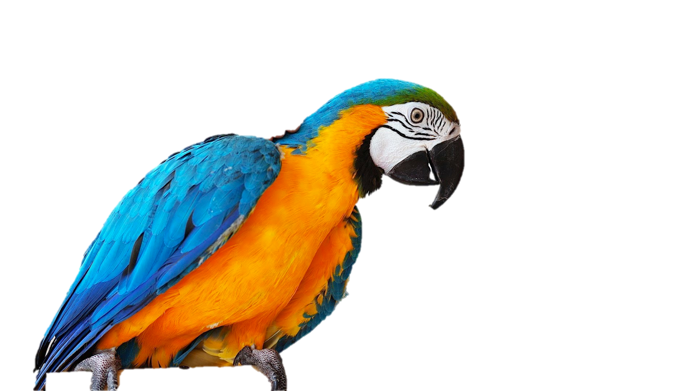
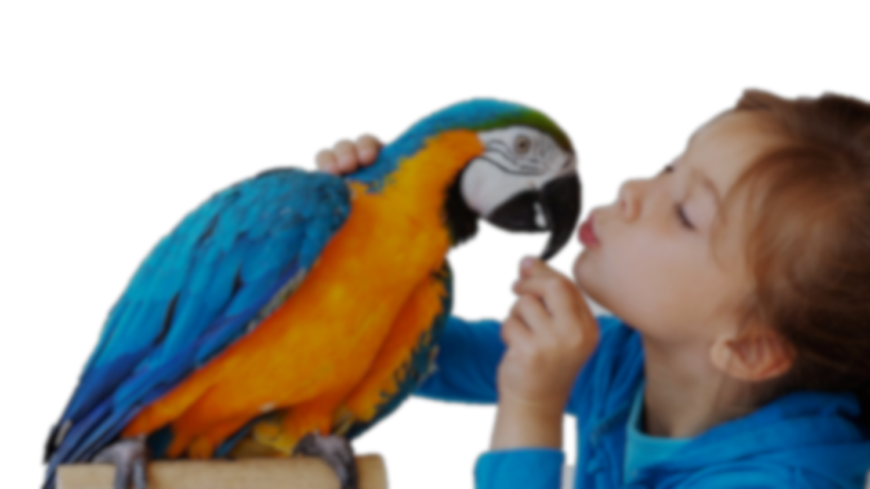
Today humans have about a 5% error rate when it comes to object recognition
Today’s Deep Learning algorithms have a 3% error rate when it comes to object recognition
Machine Learning has about a 25% error rate when it comes to object recognition
There was a time when a 3 year old could spot a bird better than a computer…
91 26 20
65 22 77 12 19
18 04 33 97 32 16 02
19 16 85 92 62 25 11 00 01 11 06
12 19 55 12 32 65 22 77 12
18 04 33
01
21 29 76 25 19 58 82 32 42
81 99 62 02 71 08 29 11 31 02
112 19 155 12 32 165 22 77 19
14 92 03 59 11 43 87 78 19 22 13
18 204 33 97 32 216 102 128 55
05 19 16 85 92 62 25 11 00 01 11
81 19 06 215 19 16 12 22 19 01
108 09 226 52 111 255 221
08
26
Notes:
Contrary to popular belief, deep learning (DL) isn’t something magical. ... It just finds patterns and objects, and labels what it finds or “sees”. So DL is incredible useful, it’s going to change humankind, but it’s not as science fiction as it’s being played out to be, not even close. Image looking at this picture of a bird ... There was a time when a 3 year year old could spot a bird better than a computer … but that isn’t the case any longer. That little toddler’s brains looked at this bird, their brain did a whole bunch of ‘stuff’ inputting the image through their eyes and into the neurons in their brains, everything fires and out comes “Daddy, it’s a bird!” NOT the case for a computer. Traditionally, you’d get some programmer to build a learning model, that would extract features manually (feather shape, beak, eyes, claws, etc.) and build a model to classify this objects as a bird.
That programmer would spend a lot of time thinking about the features that differentiate one bird from another or differentiate a bird from a dog and build those into a model which is basically a recipe for how the computers turns the pixels it sees into a label, which in this case is a bird.
What DL is about is letting the computer do the work, you feed it images and it decides what patterns are important in differentiating one image from another. The computer just looks at a bunch of cats (or birds or whatever) and determines what patterns result in what outcome (what label or classification). This is really what DL is all about ... and that’s a very different programming paradigm than what we are used to. So Deep Learning says “Instead of writing code, you feed data to the network and the program (model) builds its own logic”.
AI and ML/DL is about automating learning in such amazing ways that it’s hard to put into words. It’s about explaining your model, yourself, your business using examples instead of instructions.
<CLICK>
In fact, in visual recognition tasks, humans have a 5% error rate.
<CLICK>
Machine Learning algorithms of old had about a 25% error rate.
<CLICK>Today’s Deep Learning algorithms have about a 3% error rate … better than humans!.
<CLICK>By converting the images into matrices of pixel values and looking for patterns within the matrix, deep learning can build algorithms that can classify and detect objects better than humans.

Slide 5
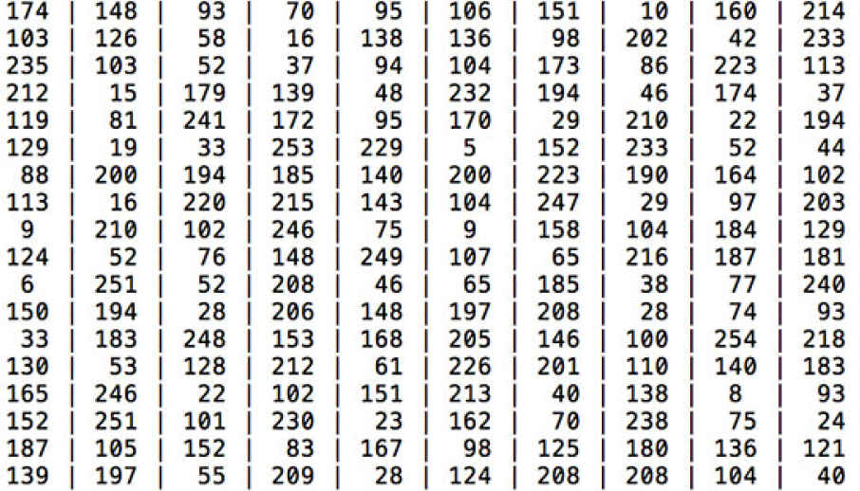
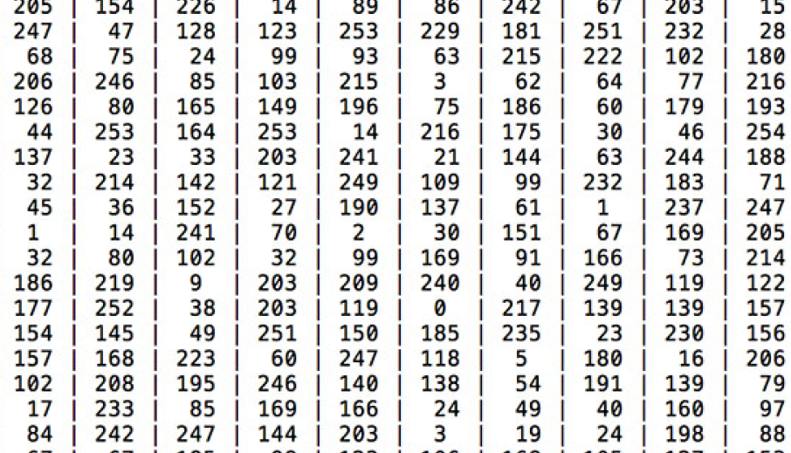
output
probability 0.80 = cat
0.15 = dog
0.05 = bird
feature extraction taking an input image, applying an algorithm, and getting out of it a feature vector (list of numbers) that qualifies the image
Notes:
Humans look at the picture of the cat or dog and see they see a cat or dog; but that isn’t how computers see. When a computer sees an image (we call that the input) it will see an array of pixel values (depending on the size and resolution of the image). Let’s assume these colored animal images are in the R(ed), G(reen), B(lue), commonly referred to as RGB, color spectrum and have resolution of 480 x 480; this means each of their representatives arrays will have 480 x 480 x 3 = 691,200 numbers within that array. Each of these numbers (the ones you see on this slide) while meaningless to us humans, are the only inputs the computer has to figure out it’s looking at a cat or a dog. Each number is given a value between 0-255 which describes the pixel intensities at that very point. In a black and white photo, they are shades of grey between black (0) and white (255). In a color picture, using RGB, these are shades of red, green, and blue respectively which make up the color being represented.
How do we go about encoding all this information in a way that a computer can understand it? The answer is to apply feature extraction to quantify the contents of an image. Feature extraction is the process of taking an input image, applying an algorithm, and obtaining a feature vector (i.e., a list of numbers) that quantifies our image. We want to apply deep learning to automatically learn a set of features that can be used to quantify and ultimately label the contents of the image itself.
The idea is that we give the computer these arrays of numbers and it will output numbers that describe the probability of the image being a certain class (for the top, 80% probability for a cat, 15% chance that it’s a dog, and 5% likelihood of a bird) and similarly for a dog (only with different weightings).
Zebra image is from: https://developer.apple.com/library/content/documentation/Performance/Conceptual/vImage/ConvolutionOperations/ConvolutionOperations.html.

Slide 6
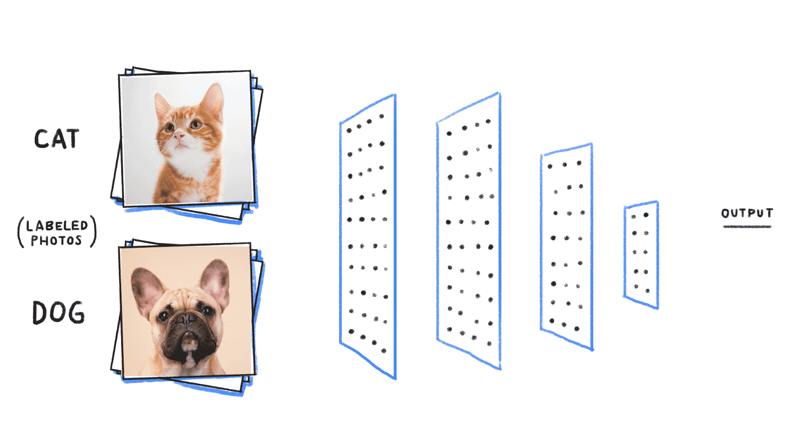
Notes:
The way this works is that the array of images is processed by a set of layers. In deep learning the various layers are Input Layer (the first layer that takes in the image), followed by a set of hidden layers that are looking at various aspects of the image and processing what they get from the layer before them, followed finally by the output layer (which tells us if it things it found a dog or a cat in the case above).
When we get the output, the training runs will compare what the real value is (is it a dog or a cat) with the prediction. If the prediction is correct then the DL algorithm will “reinforce” the path that led to the correct decision. If the prediction was wrong, the DL algorithm will go back through the neural network and “weaken” the predictors that led to the incorrect decision with the hopes that the next time a similar image comes through the network that we will make a better predictions next time.
If you want to understand how Convolutional Neural Networks work in more detail, you can go to where we got the source of this slide below:
Source: https://becominghuman.ai/building-an-image-classifier-using-deep-learning-in-python-totally-from-a-beginners-perspective-be8dbaf22dd8

Slide 7
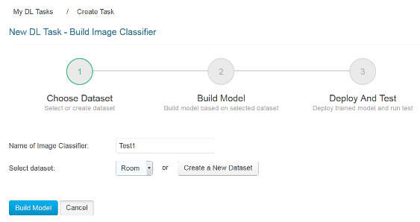
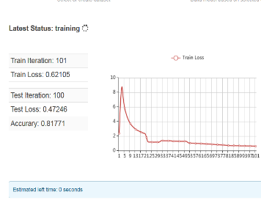
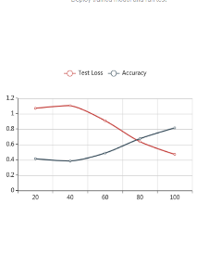
PowerAI Vision: ”Point-and-Click” AI for images & video
Label Image or
Video Data
Auto-Train AI Model
(no coding, just point and click)
Package & Deploy
AI Model
Notes:
IBM PowerAI Vision is designed for business users with little to no expertise in deep learning. Business users often have access to volumes of images and videos that they are trying to gain insights from. However, they struggle with 3 key aspects – labelling data, training models, and deploying models for inference. Note that we discussed inference in other sessions but to just recap here, inference is the part of AI where we use the model to make a prediction based on the patterns we have seen in other images. For example, we may have a model that classifies images as dogs or cats and the inference step takes a new picture and classifies it into one of those two categories.
Data labeling is the most laborious task, consuming 80% of the time dedicated to a typical deep learning project. PowerAI Vision provides a labeling tool which allows a business use, not a data scientist, to label images and videos. In addition to manual labeling, PowerAI Vision allows clients to build a model based on a small subset of the data and then use auto-labelling to accelerate the rate of creating additional labeled datasets for more in depth training.
Once labelled, image classification and/or object detection models can be created with just the click of a button.
Once a model is created, it’s yet another single click to deploy the model and test it out with new image datasets. Or you can deploy the model on an FPGA device or other edge device for rapid and scalable inferencing.
PowerAI Vision provides a complete ecosystem where even a novice user can label, train, and deploy deep learning models to build AI vision solutions.

Slide 8
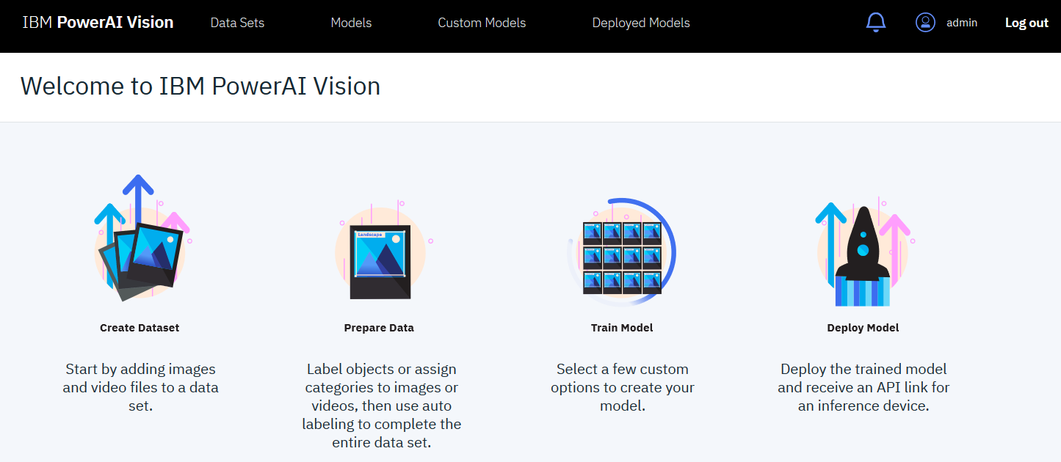
PowerAI Vision core capabilities
Notes:
As previously mentioned, PowerAI Vision has 3 core capabilities: Label, Train, and Deploy. This slide shows you the home screen of the PowerAI Vision toolset; as you can see, it is designed around these 3 tenets.
The rest of this deck will walk through each of the capabilities in order. But before we get into the specifics, let’s look at some of the terminology we will use in this course to make sure that you understand what each of these terms means as they are the key advantages provided by PowerAI Vision.
Classification of images is the act of identifying what is inside of an image and putting that image into one of the classifications that have been created as part of the labeling of the images.
Object detection is the act of finding various objects within an image. It is the analysis of images and/or video to detect objects that have been labeled previously in similar images. Note that with classification, an image is classified into one group; in object detection, you may find multiple objects within a single image.
Auto labeling is the ability to use a partially trained model to assist the user in labelling addition objects in other images. This allows for rapid processing of image data sets so that a novice user can create larger datasets to train more accurate models with.
Data augmentation is another way to create larger datasets to use when training a model. With augmentation, images that are already classified can be changed (rotated, flipped, colours changed, blurred, sharpened, etc.) in order to build additional images that can then be used to make your models more accurate.
Once the model is created, you need to be able to call the model from your application in order to make an inference. PowerAI Vision creates a REST API endpoint automatically for you when you deploy the model that can easily be integrated into an application; this is particularly useful for web-based microservices applications.

Slide 9
PowerAI Vision Label Train Deploy
Notes:
Let’s first look at the labelling of data and how simple PowerAI Vision makes it for a non data scientist.

Slide 10
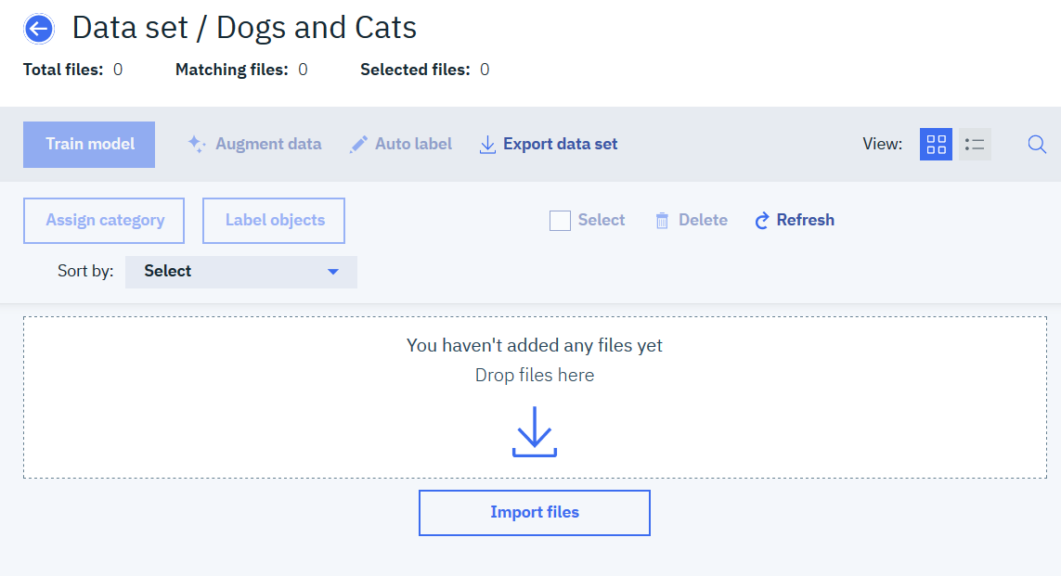
First you add data by simply creating a new data set, give the data set a name, and upload your images or video
Notes:
Labelling of images or objects is really the domain of the business user, image analyst, or data domain expert. That is, data scientists should focus on the machine learning and deep learning algorithms but it’s a Doctor, for example, who should identify what image is a malignant melanoma, or a benign mole, or a different type of tumor. Or as another example, a structural engineer can determine if an image of a cell tower shows signs of structural damage or not due to a wind or ice storm.
In order for a data scientist to train their models, they need labeled data. That’s where PowerAI Vision connects the two personas. With PowerAI Vision, the domain expert can load in the data sets and label them without the need for a data scientist. Simply click on “Create new data set” and then either drag and drop images onto the page or import a zip file full of images that are already organized.
Note that PowerAI Vision supports only JPEG and PNG file formats for images. For videos, PowerAI Vision supports .oog, .webm and .mp4 files via the graphical user interface (GUI) and also supports .mkv, .avi, .mpg, or .mpeg2 files via an API interface only (these formats are not available via the GUI).

Slide 11
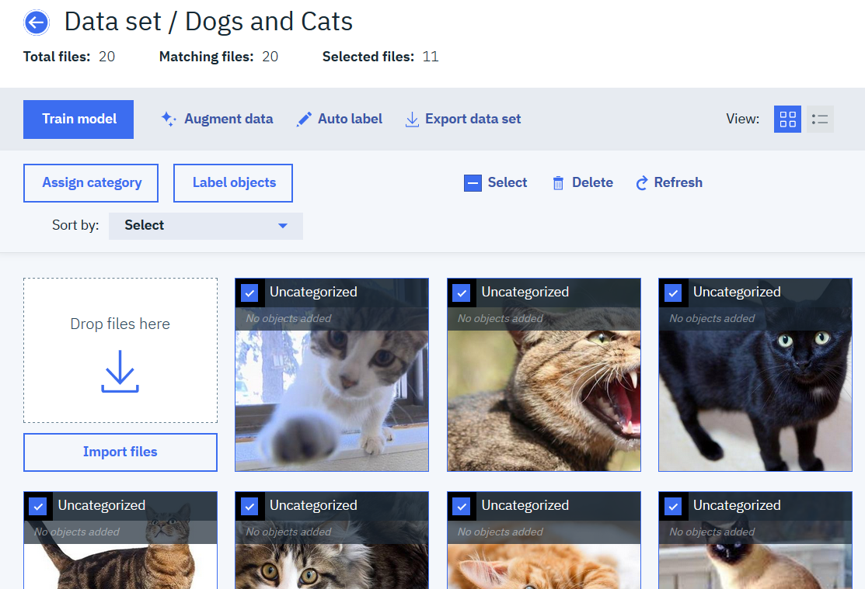
For Image Classification you then select the images and assign a category
Assign “Cat”
Notes:
Once the images are uploaded to PowerAI Vision, the user has the option to classify the images or label individual objects within the images. In the example on this slide, we select all the cat pictures and click on “Assign category” and type in the word “cat” to label each of these images as being an image of a cat.

Slide 12
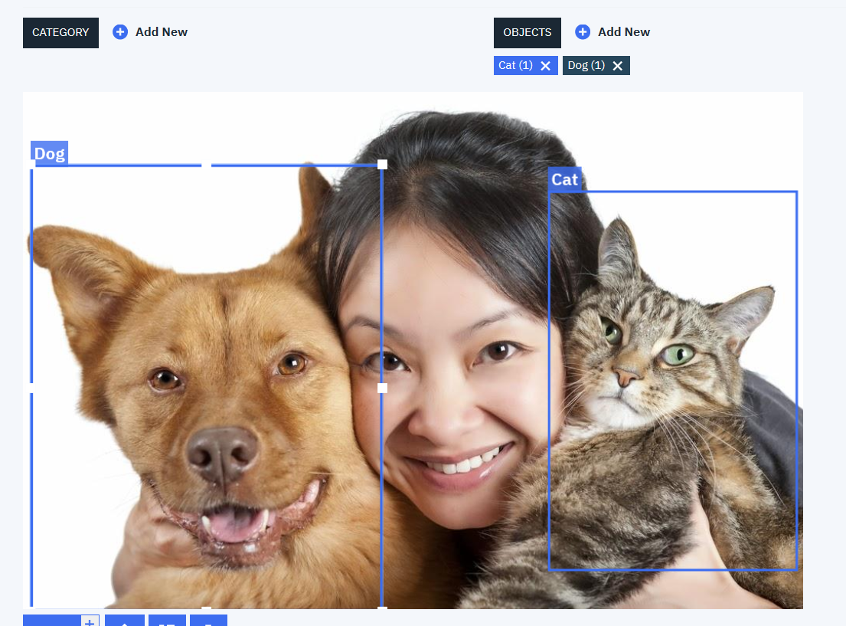
For Object Detection, define object labels and simply create a bounding box around the object with the correct label
You don’t need to know anything about deep learning
You just need to know how to label objects within an image
Notes:
Alternatively, if you want to identify objects within an image you can click on “Label Objects” which allows you to create any labels you like. In this case, we created one label for cat and a second label for dog. You then select the appropriate label and draw a bounding box around the image for that label. For the dog in this image, just select the “Dog” label and then click in the top left of the image of the dog and drag your mouse to the lower right in order to create a box around the dog; do the same for the cat and now you have an image that contains two objects within it.

Slide 13
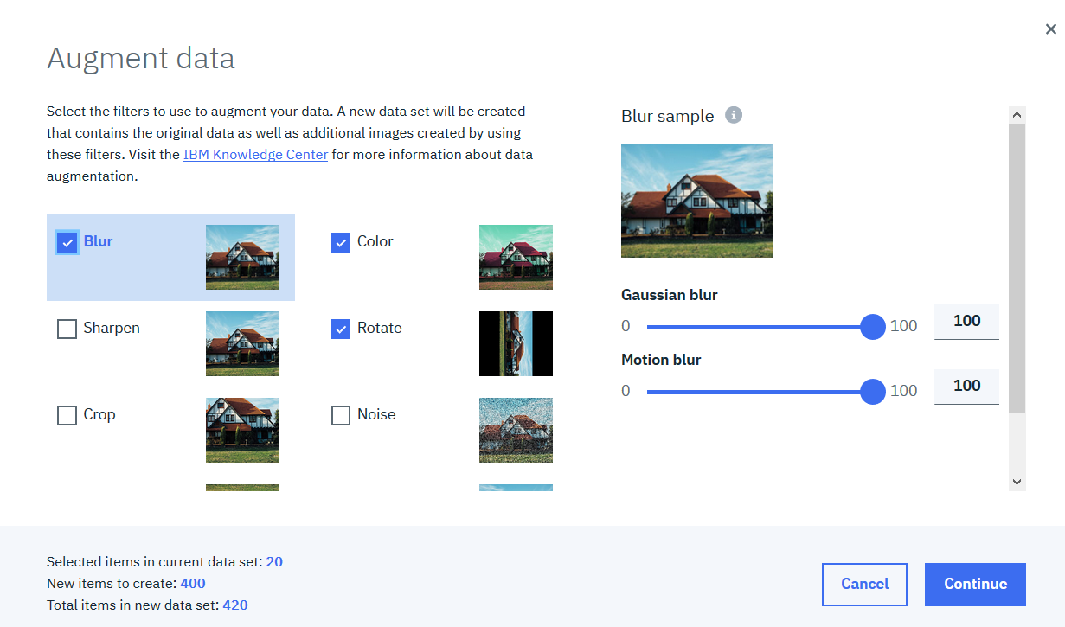
Generate additional data using automated image augmentation
Notes:
Augmented data reduces overfitting for small datasets and increases accuracy.
In this example we started off with just 20 images (as shown in the lower left of the screen). By selecting blur, color, and rotate, we can instantly create an additional 400 images that can be used for training that change the color of the pictures, rotate the images, and blur the images in order to train the model for higher levels of accuracy.
Models don’t train with higher accuracy when there are not enough images in any given category or object type. PowerAI Vision provides a simple point and click interface to augment existing datasets and introduces variations that will ultimately help the model to perform better. For example, PowerAI Vision’s built-in algorithms will crop, rotate, flip, or deteriorate images with brightness and contrast adjustments (among other transformations). This increases the samples size for training and ensure models are built with higher accuracy.

Slide 14
PowerAI Vision Label Train Deploy
Notes:
Now let’s look at how easy it is to train a model.

Slide 15
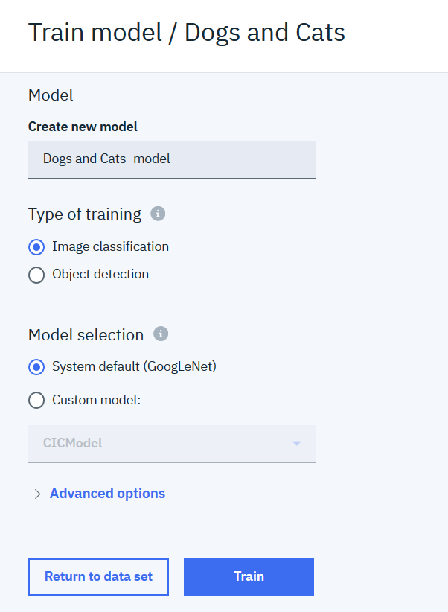
Train your model
Simply click on “Train Model”
Select either an Image Classification or an Object Detection to train
Choose the default model or import your own TensorFlow models if you prefer
Under advanced options you can tune hyperparameters if you like or go with the defaults already set for you
Notes:
Still without the need for a data scientist, a domain expert can take the data sets that they have just labeled and click on “Train Model”
The next screen asks if you want to train a model that will classify images or if you want a model that will detect objects within an image. Note that there is a pre-built model that will be used to classify images, but if you do have a data scientist, you can select “Custom model” which allows you to import a TensorFlow model you have already created in order to train a new model on this data set. We will discuss the advanced options in a later slide.
Just click “Train” and it will begin to train the model.

Slide 16
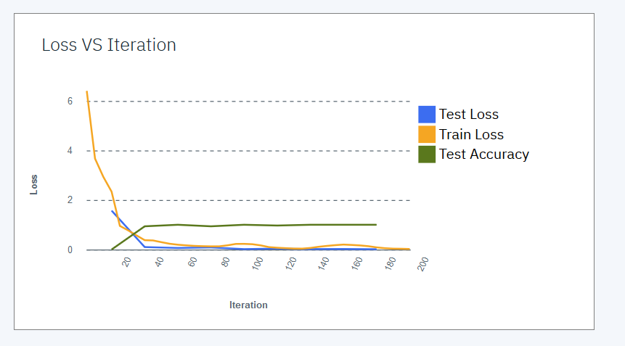
While the model is training you will be shown the loss function as the iterations are running
Notes:
While the model is training, you can see the loss functions right on the screen (which update dynamically as the model is training) to see how the model training is performing. If you find that there is no further increase in accuracy after a period of time, you can stop processing at that point. Similarly if you find that the accuracy is not increasing and the loss function is not decreasing sufficiently, you can abort the training run and go back to the data to label more objects, add more data, or perform more data augmentation in order to get a data set that can deliver higher levels of accuracy.

Slide 17
When the training is complete you can review the details of the model or deploy it with the click of a button
Notes:
Once the training is complete, you can see the details of how the training performed by clicking on “Model details” (more on that later) or you can simply click “Deploy” and PowerAI Vision will create a REST API endpoint that you can use to test or to deploy your model directly into an application (more on this is coming later in this presentation as well).

Slide 18
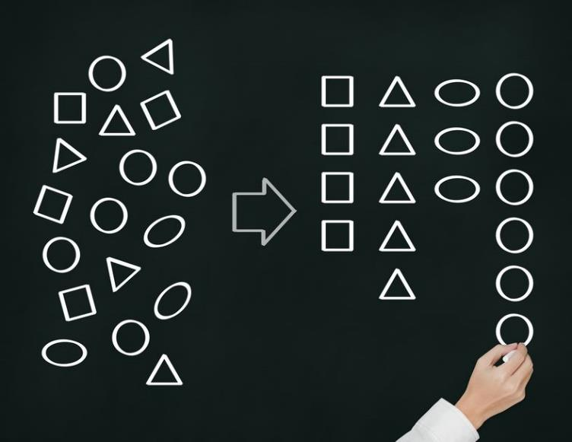
PowerAI Vision Image Classification
Notes:
Let’s take a deeper look at image classification. Remember that classification of images is the act of identifying an image and putting that image into one of the classifications that have been created as part of the image labeling process.

Slide 19
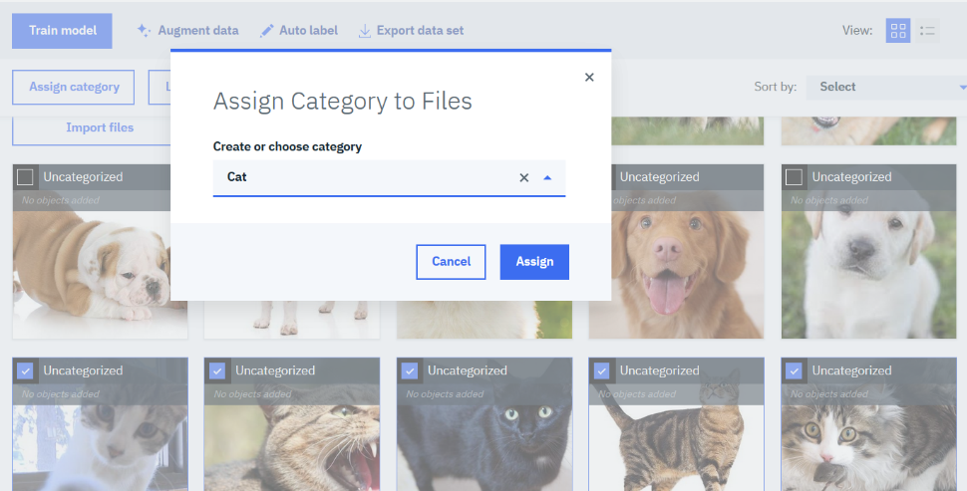
After adding images, simply assign images to categories no need for a data scientist, just domain knowledge
You don’t need to know anything about deep learning
You just need to know how to classify images into categories
Check the boxes for a given category and assign those images to that category
Notes:
In the previous example, the classification of images as cat or dog was used. To do this in PowerAI Vision, you simple select all the images you have uploaded that are dogs and then click “Assign Category” and type in the word dog. Then you select all the images you have uploaded that are images of cats and you click “Assign Category” and type in the word cat.
You can add more images and assign them to either the cat or dog category that you have already created or you can create a new category if you are classifying images that are more than just dogs and cats.

Slide 20
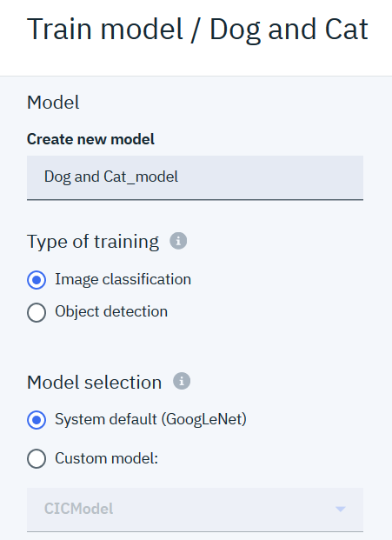
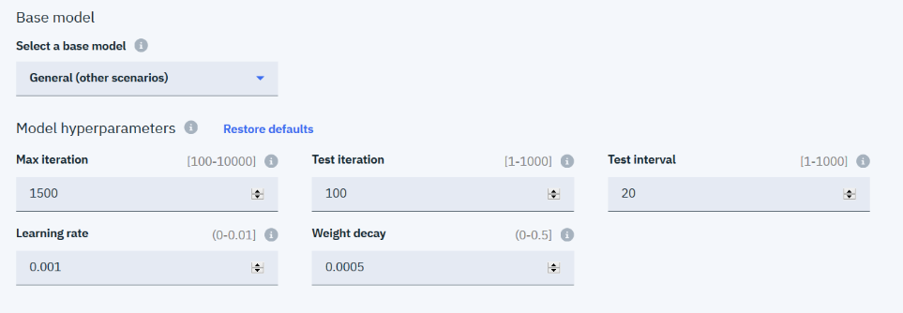
With Image Classification you have advanced settings to tune hyperparameters and you can select a predefined model or import your own customer models.
Notes:
When you are trying the model, you can go into the “Advanced options” tab to tune several hyperparameters like maximum iterations, learning rates, weight decay and more. Don’t worry if your domain expert really doesn’t know much about hyperparameters as the defaults should get them a decent model while an experienced model tuner can take it from there.
There is also the option to select a base model to start from. These are TensorFlow models that have been created by IBM that can be leveraged if the objects you are classifying fit into one of the prebuilt base models. These base models will grow over time but as of today (4Q2018) the base models that are available are:
General (any other scenario not listed below)
Flower (various flowers)
Landscape (mountain, coast, forest, country side)
Chinese Food (dumpling, rice, noodle, seafood, etc.)
Action (fishing, reading, climbing, etc.)
Scene (airport, street, building, campus, etc.)
Face (human face)
Vehicle (Jeep, Car, Sport Car, SUV, Van)
These base models are customized neural networks that are optimized to identify these types of objects. As time goes on, additional base models will be added.

Slide 21
PowerAI Vision Object Detection
Notes:
Now let’s take a deeper look at object detection. Remember that object detection is the act of finding various objects within an image. It is the analysis of images and/or video to detect objects that have been labeled previously in similar images. Note that with classification, an image is classified into one group where as with object detection, you may find multiple objects within a single image.

Slide 22
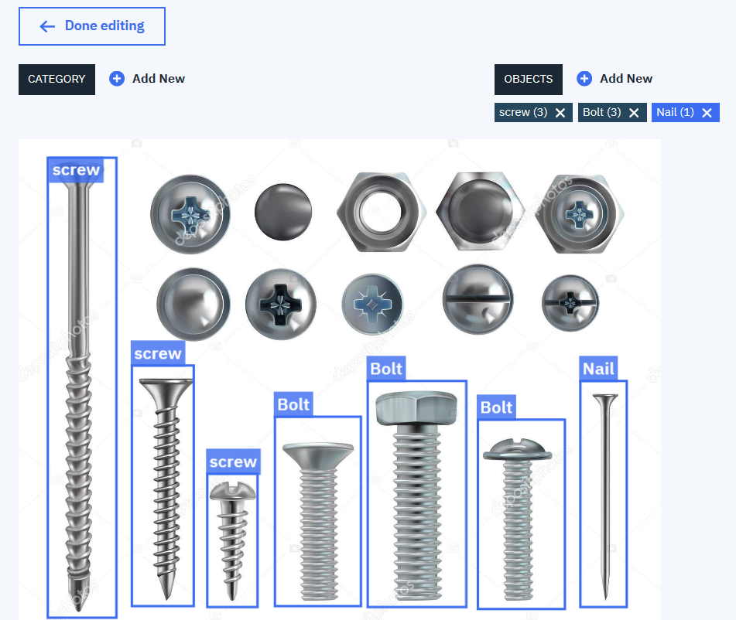
Once you have added images, simply create labels and draw boxes around the objects you want to detect
You don’t need to know anything about deep learning
You just need to know how to label objects within an image
Notes:
As previously mentioned, with object detection you create a set of labels for the various objects you want to identify. Then you click on that label in the upper right of this screen and then draw a bounding box around that object within the image. As an example, in this page, we have 3 labels identified as “screw”, “bolt”, and “nail”; the objects in the image that represent these 3 items have all been labeled.

Slide 23
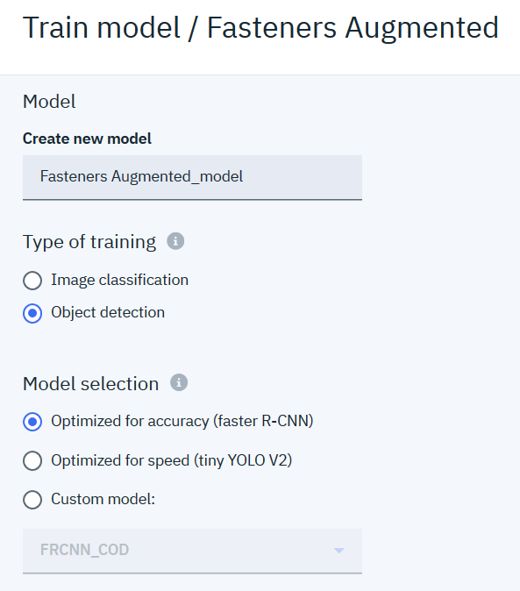
With Object Detection you have similar advanced settings to tune hyperparameters and you also have the option to select either a model that is optimized for accuracy or one optimized for speed or you can import your own customer models.
Notes:
As with image classification, there are several options that can be set when training a model for object detection. The first option is to specify if you want to train the model for the best accuracy or if you just want to do a quick training run and get a model out quickly (optimized for speed).
Of course when you are building a production model you will want to select “Optimized for accuracy” but when you are just getting started you can choose to “Optimize for speed” just to make sure that your labels make sense and that you have enough images to train a simple model (and then you can come back after to train the model for higher accuracy). You also have the option to provide a custom TensorFlow model that your data scientists have already created for you that can be used for customized model building.
The advanced options are similar to image classifications in that you can specify a set of hyperparameter values that will affect the training of the model.

Slide 24
PowerAI Vision Label Train Deploy
Notes:
Now let’s look at how easy it is to deploy a model with PowerAI Vision

Slide 25
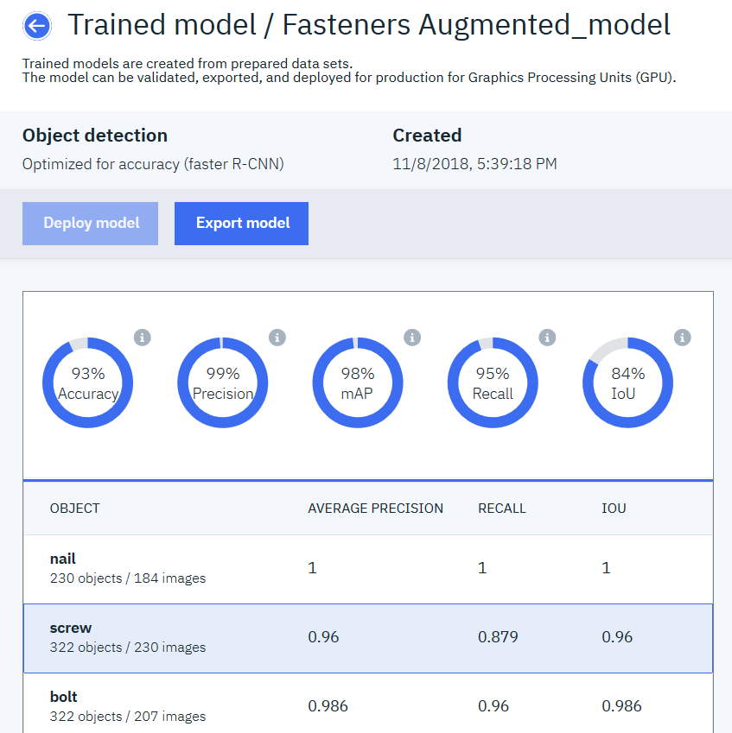
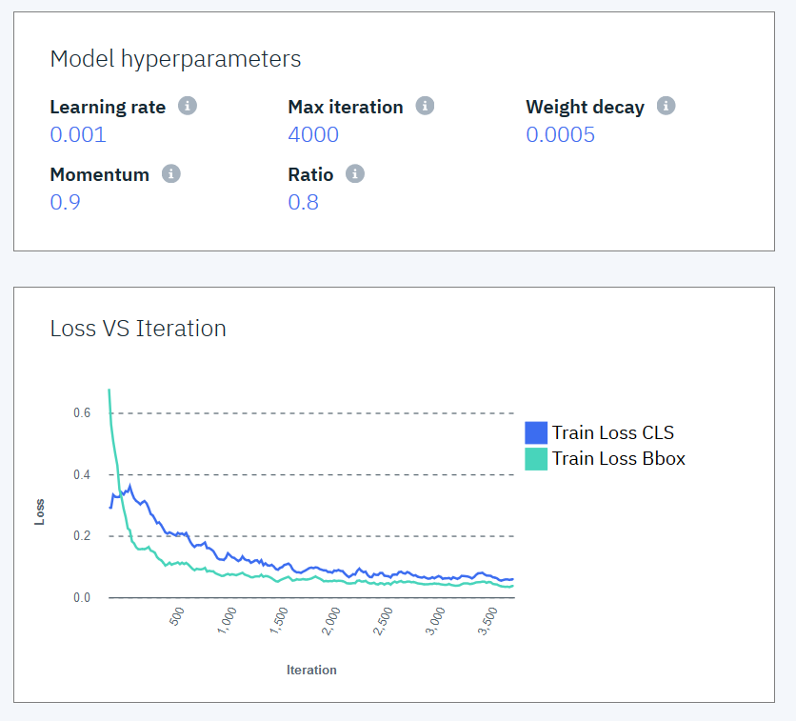
After the model is trained you can export the model or deploy it in place. Details on the quality of the model are also displayed.
Notes:
Before you deploy a model, you have the option to look at the details of the model you created. These details provide you with useful statistics so that you can determine if you model is suitable for deployment.
On the right you can see the hyperparameters that were used to create this model along with a loss function graph which give you a sense for the quality of the model that has been created (how the model performs in data scientist speak).
On the left there are additional quantitative measures on the model.
For image classification, the metrics are:
Accuracy – this measures the percentage of correctly classified images. A 93% accuracy score means that 93 of the images that were classified in this testing run were correctly identified. Accuracy includes both true positive classifications (where an image of a cat is classified as a cat) and it includes true negative classifications (where your model does NOT classify a cat as a dog).
Precision – is similar to accuracy but it measures the percent of images that are correctly classified. That is, when the model classifies an image into a category, how often is it correct? It is measuring the number of correctly classified images (a cat is classified as a cat) as a percentage of all the cats that were classified as anything (correctly or incorrectly classified (that is, how many cats were classified as cats compared to how many cats classified as cats or dogs or something else).
Recall – is similar to precision in that we are looking at the number of cats classified as cats but in this case we are comparing to how many cats are in the full data set (even if the model didn’t classify them as cats). For example, if there are 100 dogs in the data set, how many images did the model classify as dogs.
Another way to look at precision and recall is as follows…
Assume you are looking at images of cancer cells. In this case the precision would be the number of images the model classified as cancer that really are cancer cells (how many did it classify correctly). Whereas recall is the number of images the model correctly classified as cancer as a percentage of the total cancer images in the data set (how many could it find)
For Object detection (as seen above in the slide) there is Accuracy, Precision, and Recall just as there is with image classifications. Additionally there are the following two metrics:
Intersection over Union (IoU) – For object detection, PowerAI Vision will create a bounding box around the image it believes it has found. The IoU measurement is measuring how good the box is compared to the actual boundaries of the object. For example, if the bounding box of the actual object and the bounding box of the detected object are exactly the same, the IoU score would be 1 (100% overlap). However, if the detected object only overlaps with 50% of the actual boundary of the object, then the IoU will be smaller. The IoU score is literally defined as the area of the overlap between the detected box and the actual object box divided by the total area of the intersection of the two boxes.
Mean Average Precision (mAP) – This formula is more complicated as it is looking at the average of the maximum precision value across all of the objects that are being detected at each recall value. If you want to dig into this in more detail, read the detailed explanation here: http://fastml.com/what-you-wanted-to-know-about-mean-average-precision.

Slide 26
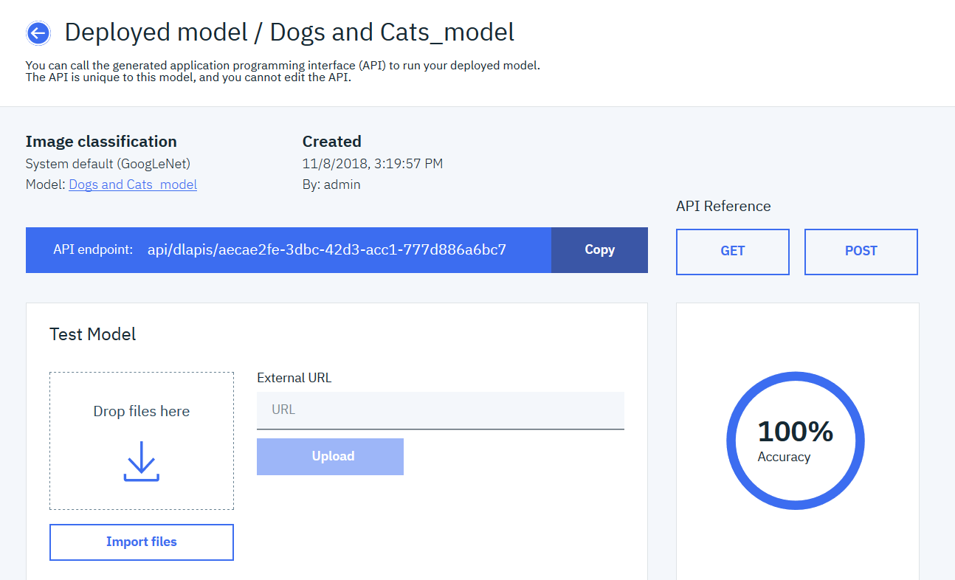
Deploy the model and access it from an API Endpoint, or test the model directly from within the AI Vision console
REST API endpoint
Test the Model
Notes:
Once the models are trained and deployed, the real return on investment (ROI) for our customers is only achieved when they start inferring and applying the models to improve the business decisions.
Application developers use rich set of APIs which can help create innovative solutions. Developers shouldn’t worry about technologies like Deep Learning, or consider infrastructure related to hosting these trained models. They should continue to use their favorite language (Java, Python) and use published REST APIs to create solutions that deliver insights to the business users.
By default, clicking on “Deploy” in the PowerAI Vision UI will deploy the model on the local server and create a REST API endpoint for application developers to use within their applications.

Slide 27
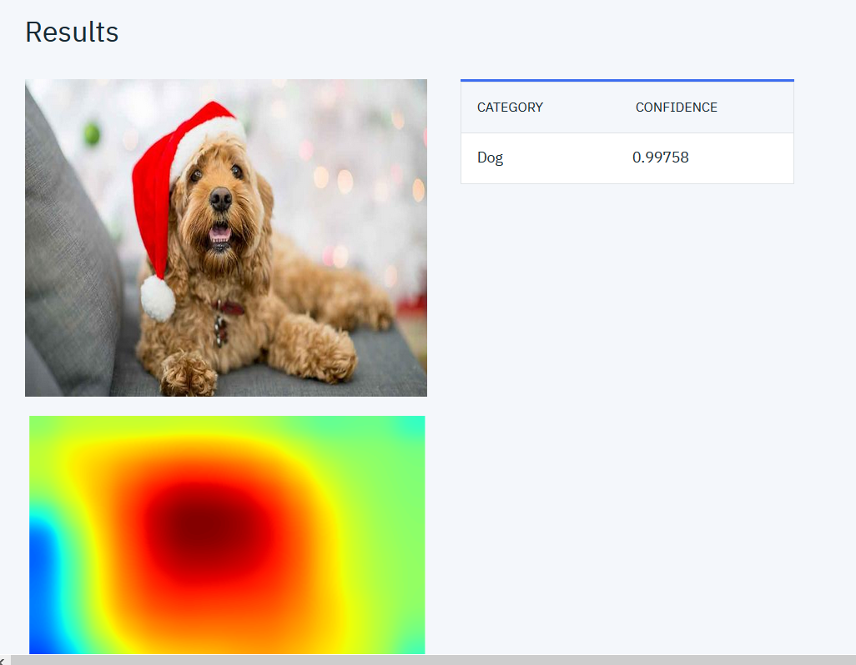
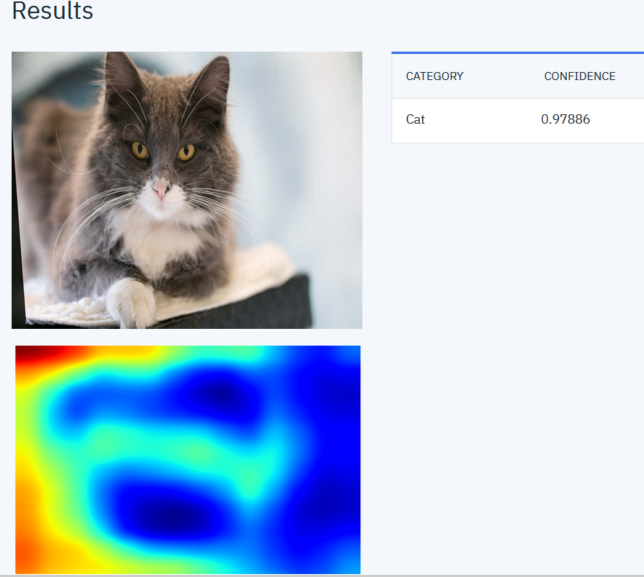
Test your model with a sample image for classification
Notes:
After deploying a model, PowerAI Vision provides a way to test images for both classification and object detection. Simply upload an image into the “Test Model” box and PowerAI Vision will perform the inference and display the results.
In the above example, an image of a dog (wearing a Santa hat) is correctly classified as a dog (with 99.758% confidence) while the image of the cat is accurately classified as a cat (with 97.886% confidence). The heat maps shown below the respective images represent the parts of the image that are most important within the classification model. For example, the red in the center of the dog heat map is telling us that the model thinks the dogs face is the most important part of the image to be able to determine it’s a dog. Similarly on the right, the cat image has a lighter blue colour right in the area where the cats whiskers appear and where the nose is: this indicates that these are important features in being able to recognize a cat.

Slide 28
Test your model with a sample image for object detection
Notes:
Similarly, you can test images for object detection. In the Fastener model, PowerAI Vision created a model for the detection of nails, screws, and bolts. When presented with the above image, PowerAI Vision correctly identifies the bolt and the screw in this picture with 84.9% and 89.6% confidence respectively. In fact you can see that the bounding boxes are quite close to the actual boundaries of the actual objects and therefore we would expect this model to have a fairly high IoU (Intersection over Union) value for this particular image.

Slide 29
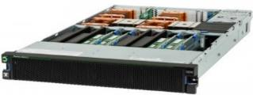
Compile optimized models to deploy on FPGA cards
Cloud or Edge
Data Center: Train model & Compile to Edge
PowerAI Inference Engine
Embedded FPGA
Model parser
Trained model
Map to Different Platforms
Neural network structure
Model analyzer
Embedded GPU
Estimate resources and performance
Backend specific optimization
Neural network processor
CPU + GPU
Mapping to
back ends
CPUs, GPUs
Notes:
PowerAI Vision provides the ability to generate deep learning models that can be inferred on edge devices. Models on edge devices promote faster insights, and allow for faster reaction times to the image being detected. This kind of deployment also allows for working offline and disconnected from the model creation server (or service). This is important because many edge devices work in real time in disconnected mode and when reconnected to a network, they upload their images and results in order to fine tune the model (which is then redeployed back to the edge device).
Edge devices can come in many forms such as smart cameras with FPGA cards (with Xilink chips), or onboard ships at sea (or under the ocean) which occasionally connect back to home base. The possibilities are endless.

Slide 30
PowerAI Vision Working with Video
Notes:
There are some special considerations when using PowerAI Vision to work with videos. In this section we will show you how to load in videos and how to detect objects within a video stream.

Slide 31
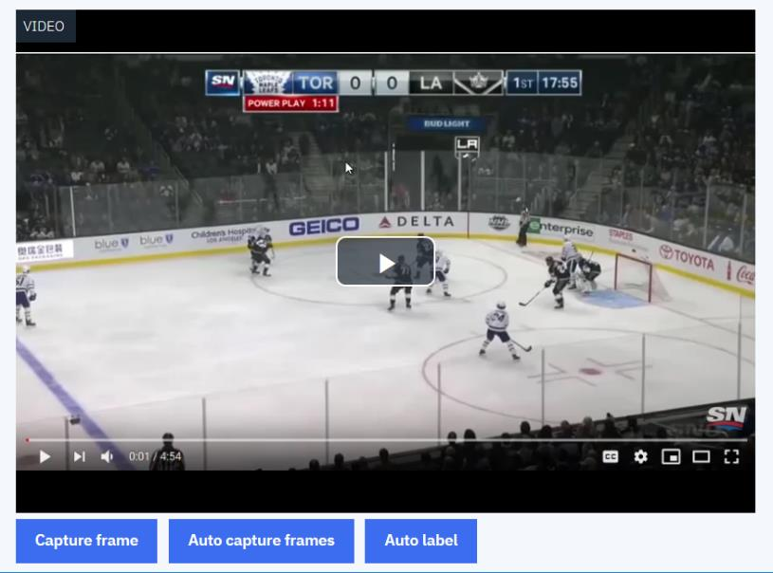
Upload video and select Label Objects
Pick which frames you want to label objects in or let PowerAI Vision automatically capture frames on an interval you specify
Notes:
The first thing to do is to upload a video file. As previously mentioned, the only file formats supported in the PowerAI Vision tooling are .mp4, .ogg, and .webm. After uploading the video, you will need to tag objects in various frames of the video with labels. It’s possible to pause a video and click on capture frame to select the frame at that point in the video. However, a simple solution is to click on “Auto capture frames” which will select a frame from the video every N seconds (where N is a number you specify). For example in a 3 minute video, you can select a frame every 5 seconds which would produce 36 frames that can then be used to label objects within those frames.

Slide 32
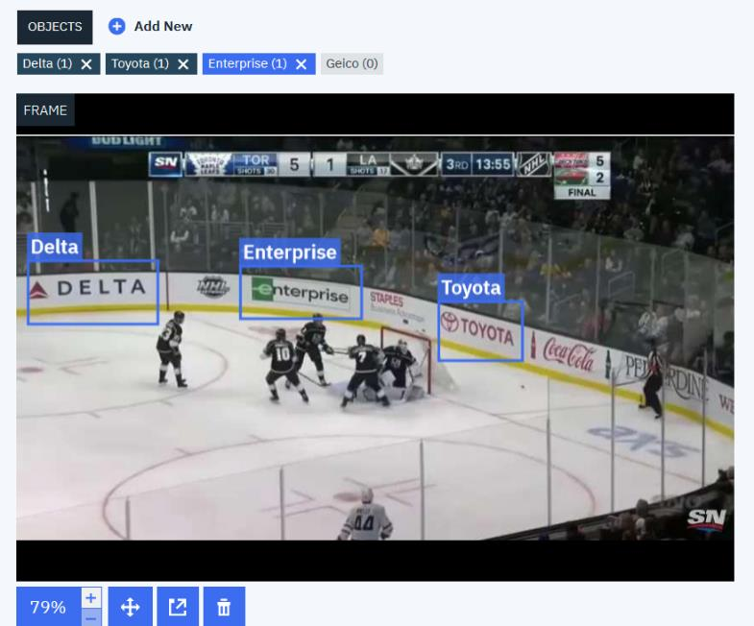
Label the frames with object names
Using a subset of the video frames, label the objects with bounding boxes exactly as you would for regular image object detection
Notes:
Once the frames have been created, object detection is then the same as it was with images. You create the object labels and then draw bounding boxes around the various objects and assign them labels.
In this example video we are showing a hockey game where there are various advertisements surrounding the area on the side boards. A marketing agency may want to know how frequent a particular logo shows up on the television broadcast. Or a company may want to evaluate how much air time they are getting for their advertisement compared to how much they paid for it, based on the position the ad is printed within the hockey arena.
In the example above we have selected four companies logos to monitor (Geico, Toyota, Enterprise, and Delta). Labels were created for these four companies and each of the frames selected was labeled with the visible objects within them.

Slide 33
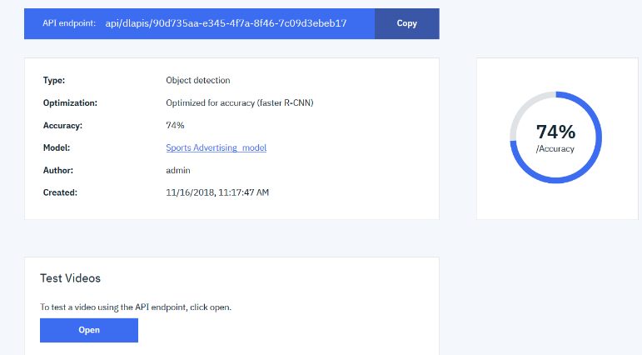
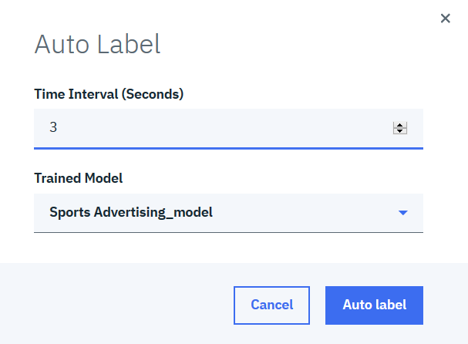
Build a simple model and then use it to auto-label more frames
Notes:
After labeling all of the objects, you simply click on “Train” to build a model. As shown above, we built a model by creating a training data set of images every 5 seconds. The accuracy of this model was only 74%. In order to improve the model we need more images to label and use for training. You can use the “Auto-labelling’ capability built into PowerAI Vision as shown on the right.
In the lower right of this screen you can see that we selected to now label frames at 3 second intervals using the trained model we created from the first run (in which we manually labelled objects at 5 second intervals). This will train our model with more data in order to train a more accurate model.

Slide 34
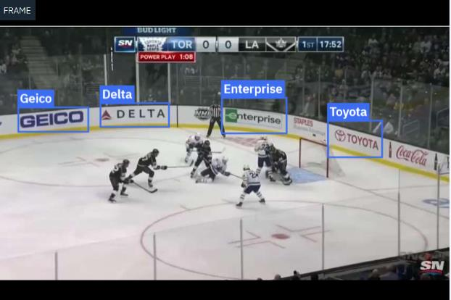
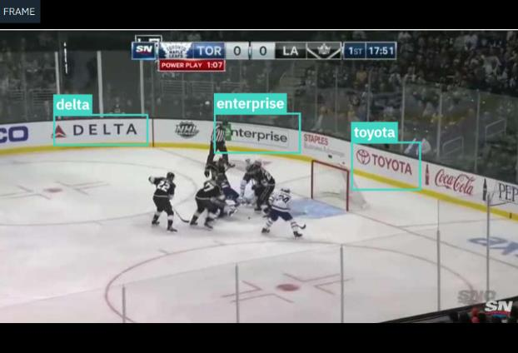
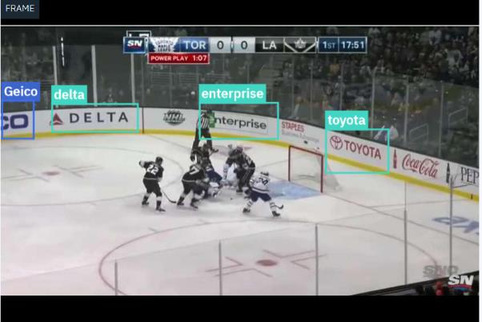
My original tagged frames
Auto labelling helps to label more frames
I just need to add in other labels it missed and then retrain with this additional data for improved accuracy
Notes:
With auto-labelling, you can see the frames that were manually trained (the image with the blue labels). You can also see the frames which were auto-labeled (the green boxes above). This gives the domain expert the opportunity to only label objects that the training may have missed or to remove incorrectly labelled objects from various frames.
In this example we added a Geico label in the bottom right. After retraining the model with more labeled data, the accuracy improved to 97%!
This auto-labelling is a huge benefit for clients as 80% of the time spent creating models is on labeling data and this tool allows for automation and improves the speed with which data can be prepared and labeled.

Slide 35
Test your model – upload a video and click “Detect”
Notes:
Here is and example of the results of the model creation. Of course this is just a graphical representation of the data. In the backend the API can be called for each frame as the video streams in and the coordinates and size of each detected object are presented back to the application for action to be taken by the end user application.

Slide 36
PowerAI Vision Roadmap, Pricing, and Competitive Comparisons
Notes:
Let’s spend a bit of time now looking at the pricing, roadmap for future enhancements and some competitive positioning.

Slide 37
Product Roadmap
PowerAI Vision 1.1 May, 2018
PowerAI Vision 1.1.1 Aug. 2018
PowerAI Vision 1.1.2 Nov. 2018
In addition to RHEL 7.5, supported on Ubuntu 18.04 (CUDA 10)
Bring Your Own Model
Advance metrics on trained models
Multiple classification of results
Inference on remote servers
x86 on CPUs and on GPUs
Power Systems on CPUs, GPUs and FPGA cards
Ubuntu and RHEL
Preview of deploying trained models on to Xilinx Alveo U200 accelerator card
Notes:
PowerAI Vision 1.1.2 is made available on November 16, 2018 and is packed with features that will help sell more of Power systems and licenses. For in depth review of these new features you can see the What’s New presentation here https://ibm.box.com/s/fx85d9oeisi908ru3i2jyc67lvx1rmmp
The focus of 1.1.2 was to make it easier for novice users and data scientist to leverage PowerAI Vision and also to increase support for a variety of inference end points. Clients can now use x86 servers to deploy models for inference,
PowerAI Vision now runs on both RHEL 7.5 and on Ubuntu.
Data scientists should be spending time creating innovating models and less time on tasks like labelling or preparing data and waiting for training runs to complete. To that end, PowerAI Vision now allows clients to build their own custom models and import them into PowerAI Vision for training and hosting of the model. In this way, a data scientist can build their custom model and pass it off to someone with domain expertise to spend the time labeling, training and deploying that model for testing or production purposes. This frees up the data scientist to focus on new models and/or innovating and iterating on existing models.
Data scientists also need improved ways to verify the accuracy of the trained models. In the 1.1.2 release, PowerAI Vision has introduced a variety of metrics that help a data scientist validate the accuracy of the model and guide them in ways that will allow them to increase accuracy.
In the 1.1.2 release, PowerAI Vision will return a sorted list of results when classifying objects each with their own confidence score. This will allow application developers to rely on the classification AND add in business logic or domain logic to improve their applications and insights. Along with this enhancement, the REST APIs for inference now accepts a threshold parameter to limit the return of categories as may be required by the application.
One of the most exciting features added in this release is the ability to deploy trained models on more devices. Power is by far the best platform for training models but there are many cases where, once trained, the models can leverage clients existing x86 infrastructure for inference. Models can now be exported out to intel servers with GPUs or even without GPUs for inference.
In the 1.1.2 release, PowerAI Vision has introduced a seamless integration to train and deploy models onto servers with FPGA cards. You don’t need to be an FPGA expert. Just click deploy to FPGA and PowerAI Vision will do the rest. IBM is partnering with Xilink to support out of the box inference on Power Systems with Xilinks new card called Alveo U200. In this release the FPGA inference is in technology preview mode.

Slide 38
Product Structure and Pricing
Offering name | Details | License type | List price | Support
IBM PowerAI Vision for Training and Inference | Limit up to 6 GPUs per server Specialized for data labeling, training and deploying on a dedicated high end server Supports deployments on ICP | Monthly term based** | $41,667/Virtual Server/month | Support included in the fee
 |  | Perpetual* | $1,000,000/Virtual server | Support for 1st year included 20% of the license price charged for S&S after 1st year
IBM PowerAI Vision for remote Inference on server | Power and x86 servers with at least one GPU | Monthly term based** | $50/Virtual Server/month | Support included in the fee
 |  | Perpetual* | $1000/Virtual Server | Support for 1st year included 20% of the license price charged for S&S after 1st year
*Perpetual available on Passport advantage and eConfig
**Monthly available only on Passport advantage
Notes:
We have 2 types of licenses for PowerAI Vision.
Monthly term based license:
There is no long term commitment for clients, they pay every month and can cancel with 30 days of notice.
Best suited for customers with operational expense types budget models who want to explore and or who are migrating from cloud to on premise environments
Customers are eligible for discounts if they pay for multiple months in advance.
Perpetual license:
This is the typical software license provided by IBM where customers pay upfront and are entitled to use the software in perpetuity. Note that this does not mean that they get support in perpetuity. In fact, clients must pay 20% of the license price every year after the first year for support and subscription (S&S). This continues as long as the offering is in support.
We are offering a maximum discount of 40% on the list price without triggering the process for Special Bids.
We should not lose opportunities on the price. In the following sections we will discuss new PowerAI pricing compared to our leading competitors.

Slide 39
Competitive Pricing
Google Vision
Provides object detection for $1.50 per 1000 frames of data labelling.
2.6 million inferences per month = $3900 per month per model
Three year total cost = $140,400 per model
Microsoft Custom Vision
Provides object detection and image classification for $1.35 per 1000 frames – No Support
2.6 million inferences per month = $3510 per month per model
Three years total cost = $126,360 per model
AWS Rekognition
Provides object detection within video images for $1 per 1000 images up to 1M and $0.80 per 1000 after that
2.6 million inferences per month = $2280 per model
Three year total cost = $82,080 per model
Use case: 1 Frame per second @30 days = 2.6 million images inferred against ONE model.
Notes:
Google Vision
Google Vision allows clients to upload images using a REST API and have the image classified into one of several thousand categories. The categories are predefined by Google making custom analysis difficult. To solve this Google now has an ML offering that is currently in Beta to allow clients to upload their own models and provide custom labelling for more realistic image classification. For details on the pricing go here https://cloud.google.com/products/calculator/#id=25d41a68-32c8-4c59-90c2-cbe671935a12 and for details on the latest capabilities in the offering you can find them here https://cloud.google.com/vision/
Microsoft Custom Vision
Microsoft Custom Vision supports data labelling and object detection. Again as a cloud service the ability to get data to the cloud for inference can be problematic in a latency sensitive environment or in an situation where images are highly confidential or personal (healthcare for example). The service costs $1 per 1000 images and an addition $0.35 per 1000 image for storage. Note that this offering is in preview mode only and therefore has no support (except via forum Q&A) and the standard offering also only allows for 10 transactions per second which makes analyzing real time video virtually impossible.
Details on pricing are available here https://azure.microsoft.com/en-us/pricing/details/cognitive-services/custom-vision-service/
AWS Rekognition
AWS Rekognition is primarily focused at archival and live stream video object detection. They are not focused as much on image classification. But using object detection within a video stream, the cost for the images is as shows above with the details available here https://aws.amazon.com/rekognition/pricing/

Slide 40
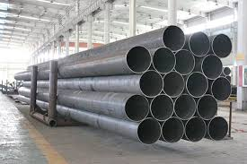
Competitive Price Comparison
Leading pipe manufacturer has 800 camera feeds to manage inventory and delivery processing 132 million images per month
~ $960k / 3 Year
PowerAI Vision with AC922 – unlimited API usage
~ $3,000,000 / 3 Year
AWS Rekognition – pricing based on API use
~ $3,300,000 / 3 Year
MS Custom Vision – pricing based on API use
~ 4,800,000 / 3 Year
Google Vision – pricing based on API use
Notes:
A leading manufacturer that builds pipes used in oil rigs has a use case that is extremely simple: count pipes in the storage area and call the trucker to transport them when there is sufficient pipes to transport. However, they run at scale with 800 cameras across their 50 plants which each take a picture that needs to be analyzed every 15 seconds. That’s 132 million images to be processed each month. This is just for one use case and one model running off of those camera images. If a client has a second model they want to deploy, in an API based pricing model the price then doubles. With PowerAI Vision you pay a fixed rate based on the server, not based on the number of API calls you make.
Using the pricing from the previous slide, you can see that PowerAI vision is between 1/3rd and 1/5th the price of the competitors solutions. Note that we are using estimated street pricing in the above scenario which includes discounted software pricing for PowerAI Vision (at 40% discount). The cost for PowerAI Vision is calculated at a discounted rate of $300,000 per year for the software (over three years is $900k) plus $60k for the one AC922. The discounts applied to the competitors offerings are based on the volume discounts based on the number of API calls used in a month. Obviously the larger the number of API calls the bigger the price differential between PowerAI Vision and competitors offerings and when there is very little usage, the competitors solution will be lower cost. That said, if clients are looking to be successful they should plan for multiple models deployed and high inference usage.
Use the following points while discussing pricing with a customer:
Vision based services on Cloud start low but quickly add up as the volume of images and the number of models increase.
PowerAI Vision has a fixed price regardless of the number of models built, deployed or used for inference.
The powerful PowerAI Vision toolset enables business users to label, train and deploy models. There is no dependency on a data scientists which can reduce overall costs since the average onboarding cost of a data scientist in the US is around $400K/year.
When the costs are computed over a period of time (TCO), PowerAI Vision is 25% the cost of our tier #1 competitors

Slide 41
Competitive Price Comparison
Reality TV show analyzing a months worth of video to create a 1 minute trailer looking at over 2 million images
Running many models against the same data, looking for facial features, object detection, emotions, logos, celebrities, actions, sentiment and speech
~ $960k / 3 Year
PowerAI Vision with AC922 – unlimited API usage - running 10 models
~ $900k / 3 Year
AWS Rekognition – pricing based on API use – adding just one more model would make it more expensive than PowerAI Vision
~ $1,250,000 / 3 Year
MS Custom Vision – pricing based on API use – making 10 models more costly
~ $1,500,000 / 3 Year
Google Vision – pricing based on API use – making 10 models more costly
Notes:
Here is another use case we should all be proud of. IBM Research in China worked with a leading entertainment broadcaster (HunanTV) to create 1 minute clip of highlights extracted from a months worth of their reality show called I AM THE FUTURE. The challenge was to train PowerAI Vision to detect gestures, movement on the stage, audience clapping, sentiments on the participants & hosts. In addition, the PowerAI Vision was correlated with audio, like the sounds of clapping, and natural language processing to detect words that indicate excitement, surprise, or discouragement. This allowed Video and Audio to be incorporated together to identify clips of interest from within the videos.
The prototype was able to process 2.3 million images (equivalent to 27days of non stop video) in under an hour and generate a 1 minute highlight video. You can see the details from this news article translated into English https://translate.google.com/translate?hl=en&sl=zh-CN&u=http://www.sohu.com/a/199210230_430753&prev=search
You can leverage this for clients in the news and entertainment industry and show them how PowerAI Vision can be an integral part of their solutions.
Note that the pricing on this chart uses standard volume discounts for the competitive solutions and includes a 40% discount on the PowerAI Vision solution (client discounts may vary). It includes PowerAI vision on a fully configured AC922 and includes 24x7 support and subscription for 3 years.

